Slide 1
Accessibility Testing in Continuous Delivery Environments
Presented by:
Alistair Garrison
Director of Accessibility Research
CSUN 2018 Assistive Technology Conference
March 21, 2018

Slide 2

Introduction
Alistair Garrison
Director of Accessibility Research
17 years experience - auditing websites, and developing support tools.
W3C/WAI – Participant: Formerly Evaluation Methodology Task Force, and now the Accessibility Conformance Testing Task Force.

Slide 3

IT industry has moved past Waterfall…
Agile
Waterfall

Slide 4
Leaving Waterfall behind…
Risk
Requirements
Design
Quality Gates
Implementation
Verification
Maintenance

Slide 5
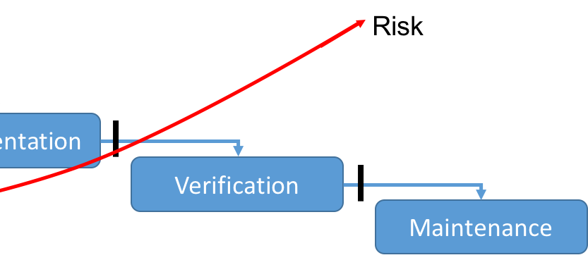
And, moving on to Agile (Scrum)…
With smaller development sprints, which each should each result in the delivery of testable software.
Risk

Slide 6
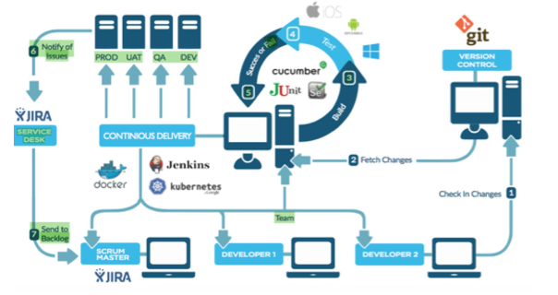
All, whilst looking to set new goal…
Today, Continuous Delivery is the goal of many companies;
Giving fast, frequent and stable software releases
Implemented through DevOps.
With a Continuous Integration (CI) server at its heart.

Slide 7
With org. changes (like DevOps) to support new software dev practices…
DevOps (from "development" and "operations")
= Those changes to an organization’s infrastructure that enhance its Agile abilities.
In order to deliver software, of the highest possible quality, in the shortest possible times.

Slide 8
Continuous Delivery = a conveyor belt…
DevOps

Slide 9
Leads to natural changes in processes...
As DevOps focuses on the heaviest possible leverage of automation and monitoring in the delivery “conveyor belt” processes, leads to natural changes in:
Requirement specification;
Development;
Software integration (Continuous Integration);
Deployment;
Testing (Continuous Testing in all the above);

Slide 10
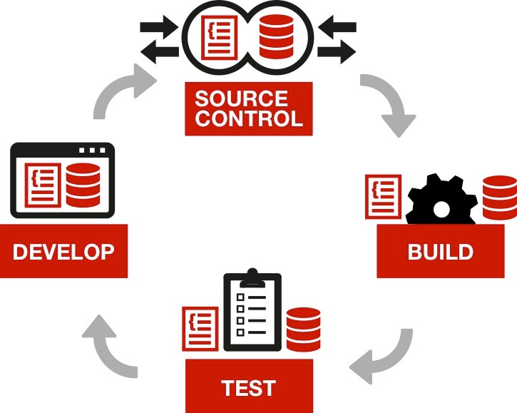
FYI - What is Continuous Integration?
Continuous Integration (CI) is a development practice;
It requires developers to check-in their code to a shared repository – ideally several times a day.
Each check-in forces an automatic re-build; then re-test of the software (from the integrated code)
So integration issues can be detected immediately.

Slide 11
FYI - Continuous Testing…
Continuous Testing (CT) is the process of executing automated tests within areas of the software delivery “conveyor belt” in order to find and remove bugs at the earliest possible point…
CT can be done at lots of testing points:
Wireframe creation
Ticket creation (Jira)
Pre-commit – of code into a repository
Commit – of code into a repository
Build – Unit Tests / Acceptance Tests
Etc…
levelaccess.com | (800) 899-9659 | info@levelaccess.com

Slide 12
So, let’s look at changes to testing activities in Continuous Delivery Envs…
Testing typically breaks-down into two types:
Functional testing: checking software to ensure that it has all the required functionality specified in the functional requirements documentation;
Non-functional testing: checking the way a system operates, rather than its specific functionality.

Slide 13
Changes to testing activities in Continuous Delivery Environments…
With an emphasis on automation, orgs are looking to break-down or change their current functional, and increasingly non-functional, testing procedures into as many fully automatable pieces as possible.
Looking for opportunities to replace manual tests with more automatable tests, like:
unit tests: which exercise coded functions to determine if they behaves as expected;
end-to-end acceptance tests: which exercise features, or more typically a parts of a feature, through simulated user interaction with a user interface, to determine if software behaves in an acceptable manner.

Slide 14
And, also consider changes to the role of the QA Tester in CD environments…
No longer the gatekeepers at specific quality gates, or just bug finders, QA testers are now tasked with leading the hunt for process improvement, by:
identifying / resolving product and process issues, or potential areas of issue;
automating existing processes; and / or changing existing processes to make them automatable – to make delivery as fast as possible.

Slide 15
Changes to the role of the QA Tester to support them in CD environments…
Whilst also advocating best practices which are known to decrease bugs (like Test Driven-Development); and
Driving adoption of tooling (general QA tools or specialized) that best supports the implementation of those best practices:
Unit Test frameworks;
BDD Test frameworks consuming requirements written in Gherkin;
Accessibility testing libraries;
Etc…

Slide 16
But, there’s also the virtuous circle effect…
A recurring cycle of events, with the result of each increasing the beneficial effect of the next… e.g.
Changes to development
Changes to QA
Changes to testing
And, in turn, changes to development resulting from changes to testing…

Slide 17
Changes to software development practices to support Continuous Testing
The emphasis on creating a delivery pipeline which is automated, and monitorable, naturally means the selection / promotion of the most testable software development practices.
Most Testable

Slide 18
Things like…
Product requirements being written directly in Gherkin;
Adoption of coding languages that have good static inspection tools (linters, etc.);
Adoption of standardized and “most able to be tested in an automatable manner”:
UI Component style guidelines;
UI Web Components (Polymer / Web Components); or UI Frameworks (e.g. Angular2, React.js,);
Adoption of test libraries / frameworks which “play nicely” with CI Servers.

Slide 19
FYI - Gherkin
Gherkin = “Human Readable + Machine Readable, Domain Specific Language that lets you describe software's behavior without detailing how that behavior is implemented”.
Requirements written in Gherkin can be run through a linter and grammar checked automatically.
And, by capturing your requirements in Gherkin they can then used as automated acceptance tests in Behavior-Driven Development (BDD) frameworks (e.g. Cucumber).

Slide 20
FYI - Web Components
W3C’s Web Components (really 4 standards) are fully-encapsulated easily re-usable and incorporable UI components.
Web Components now enable a company to have UI components that are “write once, run anywhere” ready.

Slide 21
So, how do we incorporate new testing types into Continuous Testing
As we move forward, we naturally discover new areas within our IT systems which become important to test:
Performance;
Security;
Accessibility;
Some future test type…
Etc.

Slide 22
To incorporate a new testing type into Continuous Testing…
An organization might typically start by identifying:
what functional / non-functional testing they’ll need to do;
what (in terms of artefacts) they’ll be testing;
where (in the delivery conveyor belt) that testing will take place;

Slide 23
To incorporate a new testing type into Continuous Testing… (cont’d)
And, if their current tool-chain, within their current processes, can support that; or:
if changes will be needed to those existing processes or tools;
if new tools or processes or tools will need to be created;
if changes to what is being tested will enable better automation.

Slide 24
So, what about accessibility testing?
Really, it’s just another test type. Plain and simple…
There are clear functional and non-functional components:
Functional Accessibility Testing: checking that people with disabilities, with required as necessary support from one or more Assistive Technologies, can undertake each relevant function specified in the requirements.
Usability testing for people with disabilities (by preferably people with disabilities): checking the usability of each relevant function specified in the requirements from the point of view of people with disabilities (with required support from one or more Assistive Technologies).

Slide 25
So, what about accessibility testing? (cont’d)
From a functional testing perspective
We’ll start to see the adoption of those Accessibility Techniques which are most automatically testable.
Say you have two WCAG 2.0 Techniques that broadly achieve the same thing, but one is much more automatically testable than the other, then the more testable technique is highly likely to win-out for implementation in CD envs.
Most Testable

Slide 26

So, what about accessibility testing? (cont’d...)
From a non-functional testing perspective
In CD environments, usability testing will be in the form of non-blocking “conveyor belt” style dip-tests.
For example, a certified “Trusted Tester” QA role would look to test a “sample” of features within products; both for technical accessibility, and usability.
To inform / improve the overall software delivery conveyor belt – so it inherently starts to produce accessible UI interfaces which are highly usable; without testing becoming a delivery bottleneck.

Slide 27
So, what build artefacts might contain an accessibility issue?
With regard to accessibility testing, a good starting list would be:
User stories relating to UI components / features;
UI component style guide;
Static source code:
relating to the creation of UI components;
relating to containers for UI components e.g. templates;
Data that’s bound with UI components – possibly from a Content Management System;
Rendered DOM content from dynamic code interactions.

Slide 28
Where will this accessibility testing take place?
On raising a (Jira) ticket;
Code:
whilst it’s being written;
on commit into CI;
on integration, testing rendered DOM:
Smoke tests (Happy Path);
Unit tests;
Acceptance tests;
On the “developing” product scrum deliveries, through usability “dip-tests”;
Live monitoring of released products.

Slide 29
Tooling for accessibility testing…
Static Artefact Inspection
An extension to a ticket management system (like Jira) that “on ticket creation” analyses the text of the ticket to determine if the ticket:
Is formatted correctly (Gherkin linter);
Is for a UI Component / UI feature; and if it is:
Determines if accessibility is mentioned; and
Determines if behaviors relating to the operation of the component using only the keyboard have been provided.

Slide 30
Static Code Inspection
Tooling for Accessibility Testing
Intellisense: built into many Integrated Development Environments (IDEs), this feature provides coding hints, or warnings, whilst a developer types in the code.
Linter: any tool that flags suspicious code / formatting in static source code.
By hooking into the pre-commit event, in source control servers, a linter (chosen specifically for your coding standard) can be run.
Several linters exist for popular Web Component Libraries / UI Component Frameworks which allow the source code for UI components to be checked for accessibility issues.

Slide 31
Rendered Code Testing – Standalone A11y Testing Libraries
Tooling for Accessibility Testing
A number of JavaScript-based stand-alone Accessibility Testing Engines are available, designed to allow a full range of technical accessibility tests to be run on the rendered DOM.
The old adage that “only 25% of accessibility issues are testable through automatic tests” is quickly dying (thankfully, for clean uptake of A11y testing in CD environments), as several areas of Machine Learning can be readily applied to the accessibility testing space – for example, classifiers, natural language processing, image recognition, etc…

Slide 32
Rendered code testing – Integration of A11y Libs with Testing Frameworks
Render code testing – Integration of A11y Libs with Testing Frameworks
By hooking into build events, in CI servers, different QA testing Unit testing frameworks / BDD testing frameworks can be run.
Integration packages that allow Accessibility Testing Engines to be easily included in test files are becoming increasingly common.
Noting, that the full power of these Accessibility Testing Engines becomes available when they are run through QA testing frameworks – as, you can use the QA framework to move the UI component to each of its states; and before firing the A11y tests – providing complete test coverage of paths through user tasks.

Slide 33
Sampling
Tooling for Accessibility Testing
Sampling is a very efficient way to monitor if a delivery “conveyor belt” is producing products which are of the right quality.
In recent years, accessibility testing of complete task paths has been moving beyond the use of spidering tools. As spiders are generally limited to only being able to test content in one DOM state – typically, the page load DOM state.
However, spidering tools work well as sampling tools, as you are simply looking to identify if the systems you have in place produce error free products. And, for this purpose it does not matter that you only test one DOM state…

Slide 34
Live Monitoring
Tooling for Accessibility Testing
The job of creating high-quality web applications, does not, however, stop when they are launched – even if your Continuous Accessibility Testing already provides you with a good deal of confidence in the accessibility of your product.
The ability to receive test results from all DOM states reachable by users, whilst they are using your live products / services is now achievable through embedded analytics-style scripts.
These scripts enable the QA team to detect all real-life use cases of the live product / service, in a similar, but more encompassing manner, than exploratory testing.

Slide 35
Summary
In summary, organizations practicing Continuous Delivery, generally have good patterns for Continuous Testing.
The platforms supporting Continuous Delivery enable new test types to be more easily accommodated into testing schemes, with QA testers becoming the enablers of the required business change.
The selection of code languages, style choices, and building frameworks, based on their testability naturally enables higher and higher test coverage by automatic tests – with accessibility testing being no exception.

Slide 36
Summary (cont’d)
And, with the creation of code linters checking for A11y issues, and Accessibility Testing Engines (with every increasing fully automated test coverage)… and…
Their designed integration with QA Testing Frameworks, the possibility of Continuous Accessibility Inspection and Testing becomes a real, very achievable “low-bar” possibility for organizations.
Remembering that Accessibility testing, is at the end of the day, simply just another test type to integrate into a broader Continuous Testing scheme.

Slide 37
Questions?

Slide 38




Thank You!
Contact Us
Alistair Garrison alistair.garrison@levelaccess.com
Follow Us
@ LevelAccessA11y
Level-Access
LevelAccessA11y
Level Access Blog
Slide Deck Available for Download at: https://www.levelaccess.com/csun18/

